Slide 1


Spoken Language
Identification System
Presented by:
Abdallah Ragab – 300327288
Kareem Waly – 300327303
Mohamed Elesawy – 300327237
Hosam Mahmoud – 300327269
Eslam Khalaf – 300327261
Industry Project
Beta Release Team ID: AI-7
Project ID: AI_AIMS1_May2022

Slide 2
Project Supporters
Project uOttawa Support:
Prof. Murat Simsek
Project Sponsor:
AIMs Solutions
Eng. Mohamed Soliman
Project Mentor:
Dr. Manar Elkady

Slide 3




Agenda
Problem Statement
Sponsor benefits
Solution Design
Real live Demo

Slide 4

Problem Statement
Nearly eight billion people worldwide are speaking 7,000 languages.

Slide 5


Nearly eight billion people worldwide are speaking 7,000 languages.
Problem Statement
and knowing which language a person speaks is critically problematic as it is difficult for any system to differentiate between all of these languages through voice only.

Slide 6


Nearly eight billion people worldwide are speaking 7,000 languages.
Problem Statement
The spoken Language Identification System is considered the initial stage in Natural Language Processing (NLP) operations.
and knowing which language a person speaks is critically problematic as it is difficult for any system to differentiate between all of these languages through voice only.

Slide 7

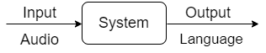
The primary objective of the Language Identification System is to accurately identify a spoken language from the given speech sample at any time length.
Problem Statement
Languages to be detected: Arabic, Italian, Spanish, Portuguese, German, French, and English.

Slide 8



Sponsor benefit
The project outcome can be delivered in different forms:
A stand-alone Application Program Interface (API) deployed as a docker container will receive requests as audio files and return the recorded audio language.
An initial module of some Practical Applications like Speech-to-Speech Translation, multilingual Automatic Speech Recognition (ASR) systems, and Speech-Activated Automated Systems.

Slide 9






Dataset Collection
Feature Engineering
Models Building
Solution Design
Select best Model
Error Analysis
Deployment

Slide 10

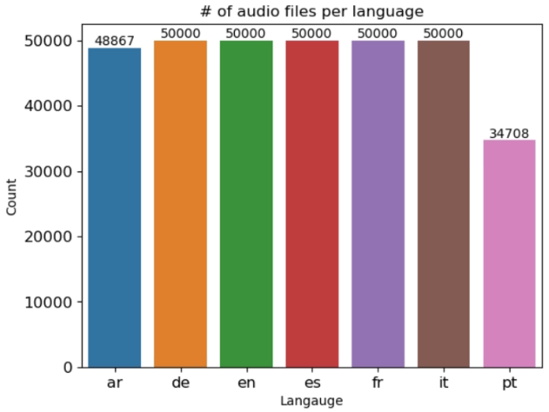
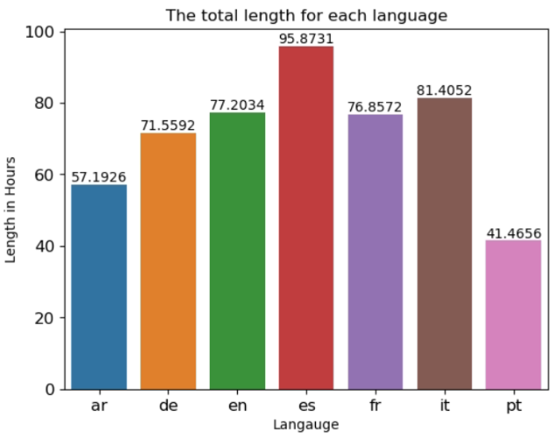
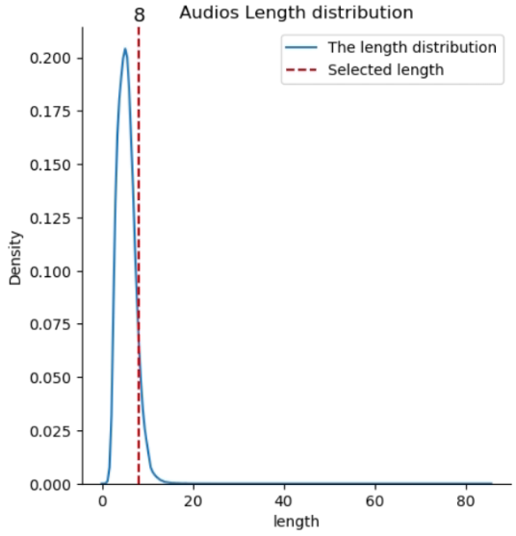
Dataset Collection
The Dataset was collected from two resources VoxForg and Mozilla Common Voice.
We sampled 25,000 audio files for each language from each dataset as the total number of files is 333,575 audio files as there are some languages with less than 50,000 audio files.

Slide 11
Dataset Collection
The Dataset was collected from two resources VoxForg and Mozilla Common Voice.
We sampled 25,000 audio files for each language from each dataset as the total number of files is 333,575 audio files as there are some languages with less than 50,000 audio files.

Slide 12
Dataset Collection
The Dataset was collected from two resources VoxForg and Mozilla Common Voice.
We sampled 25,000 audio files for each language from each dataset as the total number of files is 333,575 audio files as there are some languages with less than 50,000 audio files.

Slide 13

Feature Engineering
We have used different audio feature extraction techniques:
Mel spectrogram
MFCC
Proposed a new custom feature vector which is a combination of different features.
Audio File
Images
Feature Extraction

Slide 14
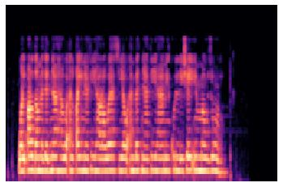
Feature Engineering
We have used different audio feature extraction techniques:
Mel spectrogram
MFCC
Proposed a new custom feature vector which is a combination of different features.
Audio File
Images
Mel Spectrogram
Feature Extraction

Slide 15
Feature Engineering
We have used different audio feature extraction techniques:
Mel spectrogram
MFCC
Proposed a new custom feature vector which is a combination of different features.
Audio File
Images
Mel Spectrogram
Feature Extraction
Combination of
MFCC
STFT
Custom Vector
chromagram
Signals
Mel spectrogram
spectral contrast
tonal centroid

Slide 16
Feature Engineering
We have used different audio feature extraction techniques:
Mel spectrogram
MFCC
Proposed a new custom feature vector which is a combination of different features.
Audio File
Images
Mel Spectrogram
Feature Extraction
Custom Vector
Signals
Mel spectrogram mean

Slide 17
Feature Engineering
We have used different audio feature extraction techniques:
Mel spectrogram
MFCC
Proposed a new custom feature vector which is a combination of different features.
Audio File
Images
Mel Spectrogram
Feature Extraction
Custom Vector
Signals
Mel spectrogram mean
MFCC

Slide 18

Models Building
Audio File
Images
Mel Spectrogram
Feature Extraction
Custom Vector
Signals
Mel spectrogram mean
MFCC
CNN 1D models

Slide 19
Models Building
Audio File
Images
Mel Spectrogram
CNN models
Feature Extraction
Custom Vector
Signals
Mel spectrogram mean
MFCC
CNN 1D models

Slide 20
Models Building
Audio File
Images
Mel Spectrogram
CNN models
Feature Extraction
Custom Vector
Different DL models
Signals
Mel spectrogram mean
MFCC
CNN 1D models

Slide 21
Models Building
Audio File
Images
Mel Spectrogram
CNN models
Feature Extraction
Custom Vector
Different DL models
Signals
Mel spectrogram mean
MFCC
Different ML Model
CNN 1D models

Slide 22
Models Building
Audio File
Images
Mel Spectrogram
CNN models
Feature Extraction
Custom Vector
Different DL models
Signals
Mel spectrogram mean
MFCC
Different ML Model
CNN 1D models

Slide 23
Models Building
Images
Mel Spectrogram
CNN models
Pretrained Models
Train Models from scratch

Slide 24
Models Building
Images
Mel Spectrogram
CNN models
Pretrained Models
Train Models from scratch
Take a Sample

Slide 25
Models Building
Images
Mel Spectrogram
CNN models
Pretrained Models
Train Models from scratch
Take a Sample
Sampling the Data to be 35,000 audio files equally distributed over all Languages.

Slide 26
Models Building
Images
Mel Spectrogram
CNN models
Pretrained Models
Train Models from scratch
Take a Sample
Generate the Mel spectrogram images from the audio
Feature extraction

Slide 27
Models Building
Images
Mel Spectrogram
CNN models
Pretrained Models
Train Models from scratch
Take a Sample
Training Models
AlexNet
VGG16
ResNet101
MaxViT, Deit_Tiny
All models were trained on the ImageNet Dataset
Feature extraction
Training

Slide 28
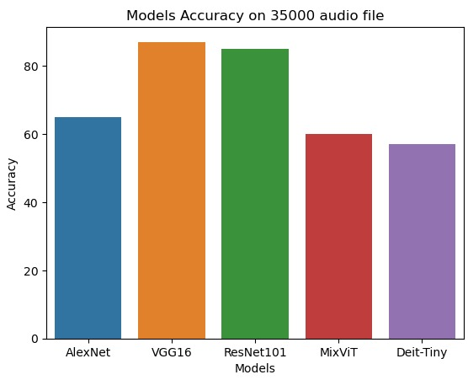
Models Building
Images
Mel Spectrogram
CNN models
Pretrained Models
Train Models from scratch
Take a Sample
Training Models
AlexNet
VGG16
ResNet101
MaxViT, Deit_Tiny
All models were trained on the ImageNet Dataset
Results
Feature extraction
Training
Model Selection

Slide 29
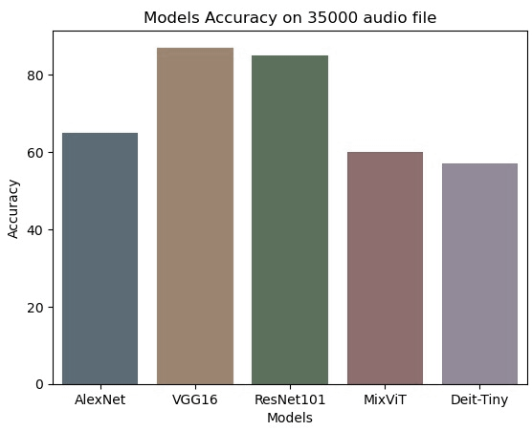
Models Building
Images
Mel Spectrogram
CNN models
Pretrained Models
Train Models from scratch
Take a Sample
Training Models
AlexNet
VGG16
ResNet101
MaxViT, Deit_Tiny
All models were trained on the ImageNet Dataset
Feature extraction
VGG16 and ResNet101 were selected for the next step.
Training
Model Selection
Results

Slide 30
Models Building
Images
Mel Spectrogram
CNN models
Pretrained Models
Train Models from scratch
Take a Sample
Feature extraction
Train the VGG16 and ResNet101 on all dataset
Training
Model Selection
Train on the Full Dataset

Slide 31
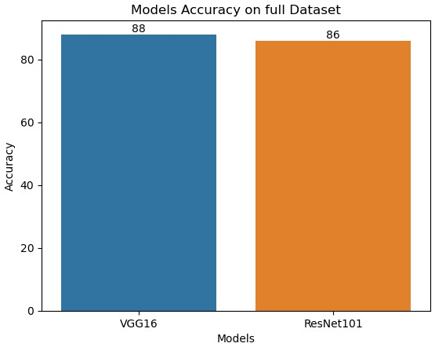
Models Building
Images
Mel Spectrogram
CNN models
Pretrained Models
Train Models from scratch
Take a Sample
Train the VGG16 and ResNet101 on all dataset
Feature extraction
Results
Training
Model Selection
Train on the Full Dataset

Slide 32
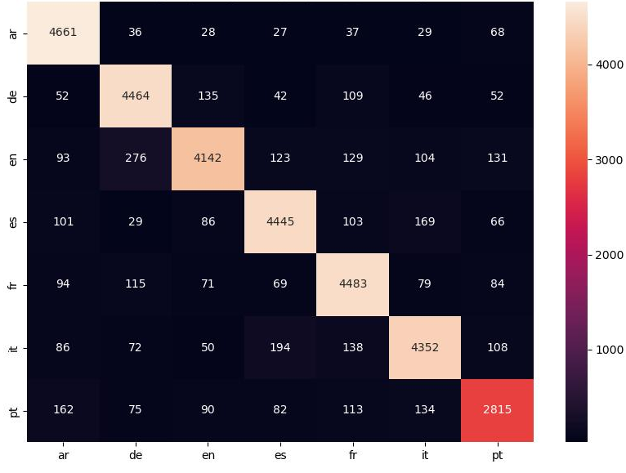
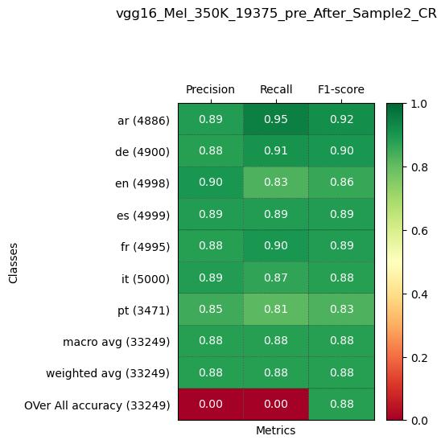
Models Building
Images
Mel Spectrogram
CNN models
Pretrained Models
Train Models from scratch
VGG16 Confusion Matrix
Take a Sample
Feature extraction
Training
Model Selection
VGG16 Classification Report
Train on the Full Dataset
Best Model Results

Slide 33
Models Building
Images
Mel Spectrogram
CNN models
Pretrained Models
Train Models from scratch
Take a Sample
VGG16 Classification Report
Feature extraction
Training
VGG16 Confusion Matrix
Model Selection
Train on the Full Dataset
Best Model Results

Slide 34
Models Building
Images
Mel Spectrogram
CNN models
Train Models from scratch
Pretrained Models
Accuracy: 88%

Slide 35
Models Building
Images
Mel Spectrogram
CNN models
Train Models from scratch
Pretrained Models
Accuracy: 88%
Take a Sample

Slide 36
Models Building
Images
Mel Spectrogram
CNN models
Train Models from scratch
Pretrained Models
Accuracy: 88%
Take a Sample
Sampling the data based on the number of minutes of each language to be 200 minutes, and then sampling based on the number of files to be 35,000 audio files evenly distributed across all languages.

Slide 37
Models Building
Images
Mel Spectrogram
CNN models
Train Models from scratch
Pretrained Models
Accuracy: 88%
Take a Sample
Generate the Mel spectrogram images from the audio
Feature extraction

Slide 38
Models Building
Images
Mel Spectrogram
CNN models
Train Models from scratch
Pretrained Models
Accuracy: 88%
Take a Sample
Training
VGG16 Classifier
Unfreeze all layers and train the VGG16 model from scratch.
Feature extraction
Baseline model

Slide 39
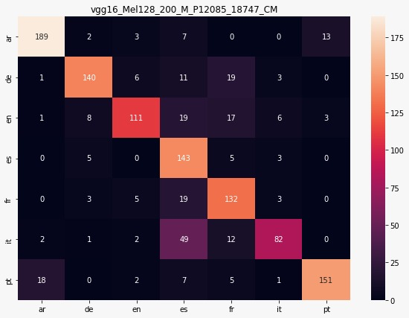
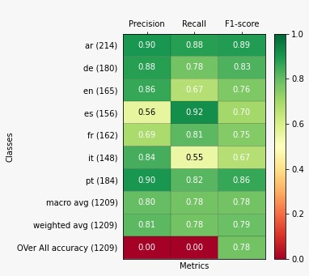
Models Building
Images
Mel Spectrogram
CNN models
Train Models from scratch
Pretrained Models
Accuracy: 88%
Take a Sample
Training
VGG16 Classifier
Unfreeze all layers and train the VGG16 model from scratch.
Confusion Matrix
Feature extraction
Baseline model
Classification Report

Slide 40
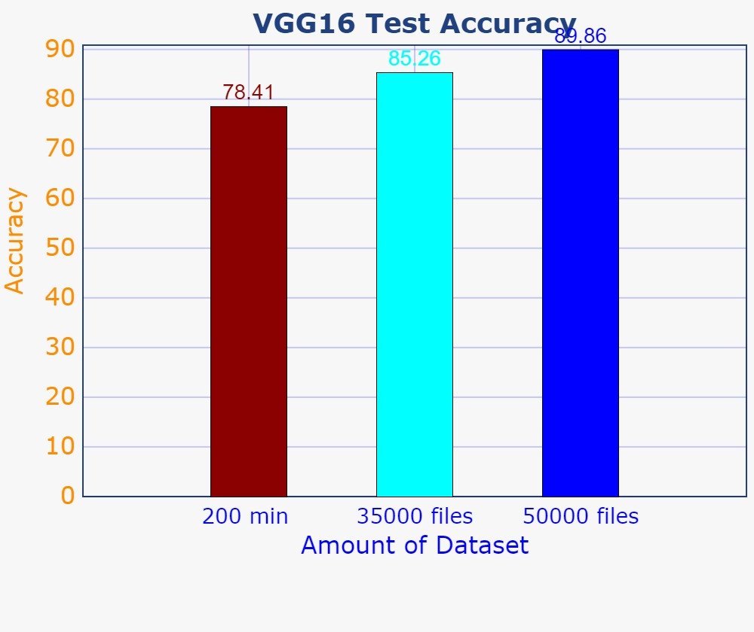
Models Building
Images
Mel Spectrogram
CNN models
Train Models from scratch
Pretrained Models
Accuracy: 88%
Take a Sample
After that trained VGG16 on 35000 Audio files, and then the whole data.
Feature extraction
Baseline model
Training Model

Slide 41
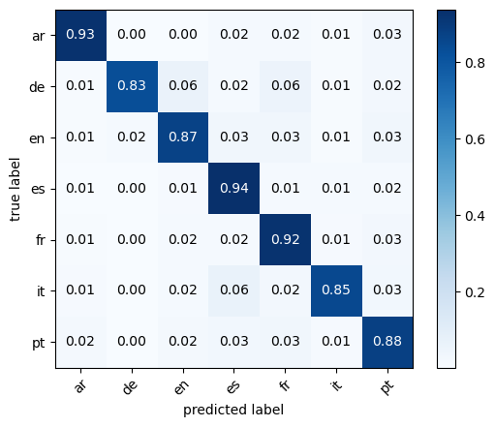
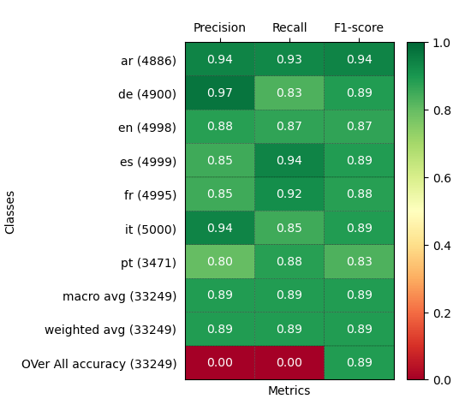
Models Building
Images
Mel Spectrogram
CNN models
Train Models from scratch
Pretrained Models
Accuracy: 88%
VGG16 Confusion Matrix
Take a Sample
Feature extraction
Baseline model
Training Model
VGG16 Classification Report
Train on the Full Dataset

Slide 42
Models Building
Images
Mel Spectrogram
CNN models
Train Models from scratch
Pretrained Models
Accuracy: 88%
Take a Sample
VGG16 Classification Report
Feature extraction
Baseline model
VGG16 Confusion Matrix
Training Model
Train on the Full Dataset
Best Model Results

Slide 43
Models Building
Signals
CNN 1d models

Slide 44
Models Building
Signals
CNN 1d models
Audio Preprocessing
Fixing the sample rate for every audio to be 8,000HZ
Fixing All Audio to have a mono channel

Slide 45
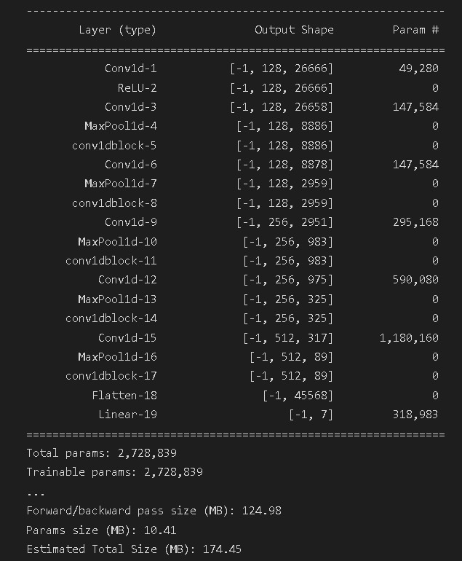
Models Building
Signals
CNN 1d models
Audio Preprocessing
Model structure

Slide 46
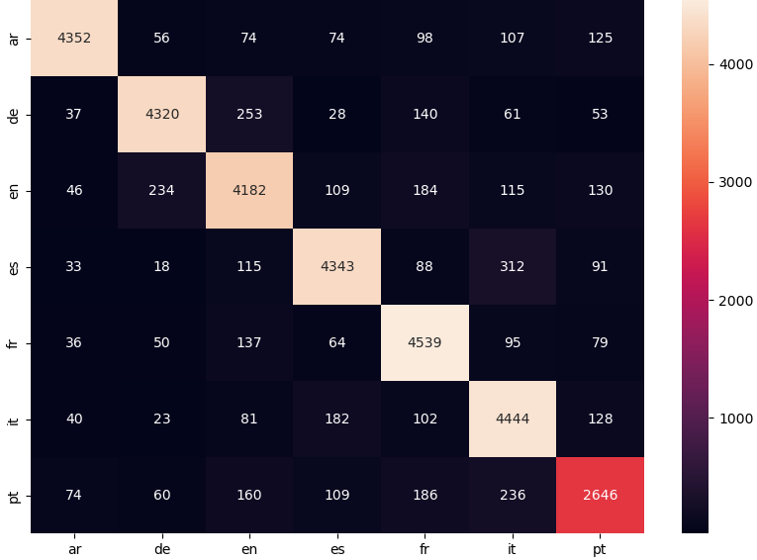
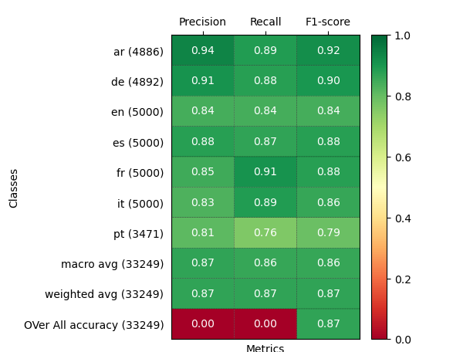
Models Building
Signals
CNN 1d models
Confusion Matrix
Audio Preprocessing
Model structure
Train on the Full Dataset
Result
Classification Report

Slide 47
Models Building
Signals
CNN 1d models
Classification Report
Audio Preprocessing
Model structure
Train on the Full Dataset
Result
Confusion Matrix

Slide 48
Models Building
Mel spectrogram mean
Signals
MFCC
Different ML Model

Slide 49
Models Building
Mel spectrogram mean
Signals
MFCC
Different ML Model
Take a Sample
Sampling the Data to be 3000, 5000, and 25000 audio files equally distributed over all Languages.

Slide 50
Models Building
Mel spectrogram mean
Signals
MFCC
Different ML Model
Take a Sample
We tried two main feature extraction on the audio data:
the MFCC and the Mel spectrogram from the audio data
then we apply both the original and transformation on the feature extraction on the trained data and choose like taking the mean and variance on the data
Feature extraction

Slide 51
Models Building
Mel spectrogram mean
Signals
MFCC
Different ML Model
Take a Sample
We applied a combination of different machine-learning models with different feature selections
Feature extraction
Model selection

Slide 52
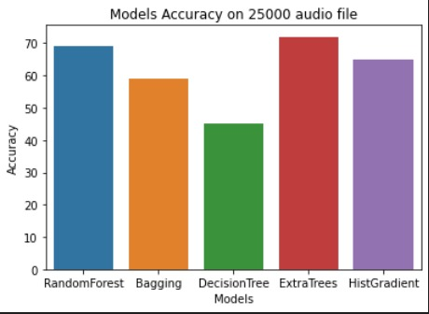
Models Building
Mel spectrogram mean
Signals
MFCC
Different ML Model
We applied a combination of different machine-learning models with different feature selections
Take a Sample
Feature extraction
Model selection

Slide 53
Models Building
Mel spectrogram mean
Signals
MFCC
Different ML Model
Take a Sample
We applied greed search on multiple hyperparameters on the models like no. estimator, l2 regularization, and no. iteration
Feature extraction
Model selection
Hyperparameter tuning

Slide 54
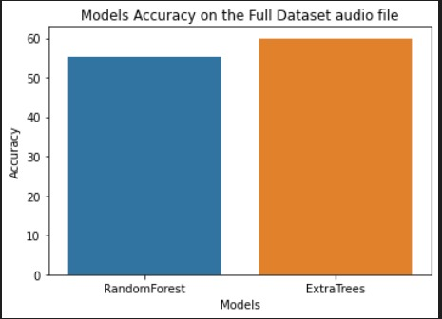
Models Building
Mel spectrogram mean
Signals
MFCC
Different ML Model
Take a Sample
Extra tree classifier was the champion model
Feature extraction
Model selection
Hyperparameter tuning
Train on the Full Dataset

Slide 55
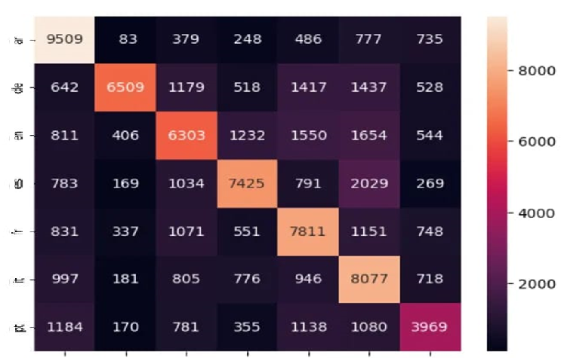
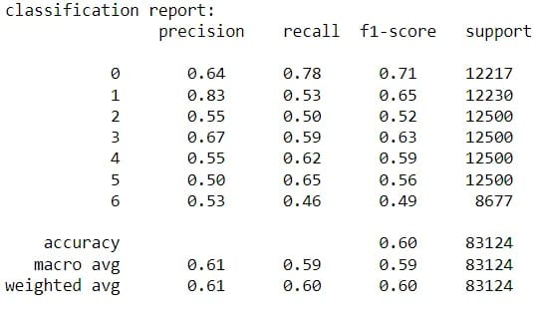
Models Building
Mel spectrogram mean
Signals
MFCC
Different ML Model
Extra tree classifier was the champion model
Take a Sample
Extra tree Confusion Matrix
Feature extraction
Model selection
Hyperparameter tuning
Extra tree Classification Report
Train on the Full Dataset
Results

Slide 56
Models Building
Mel spectrogram mean
Signals
MFCC
Different ML Model
Extra tree classifier was the champion model
Take a Sample
Extra tree Classification Report
Feature extraction
Model selection
Extra tree Confusion Matrix
Hyperparameter tuning
Train on the Full Dataset
Results

Slide 57
Models Building
Signals
Custom Vector
Different DL models

Slide 58
Models Building
Signals
Custom Vector
Different DL models
Sampling audios
Sampling the Data to be 35,000 audio files equally distributed over all Languages.

Slide 59
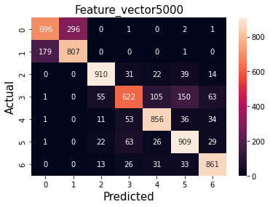
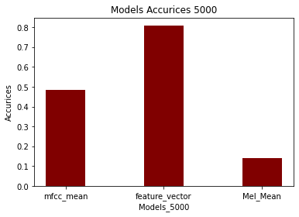
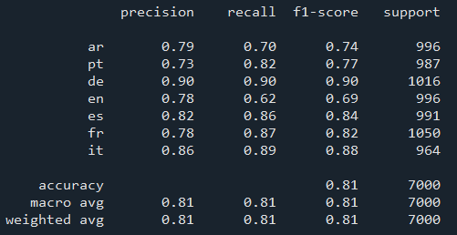
Models Building
Signals
Custom Vector
Different DL models
Sampling audios
Confusion Matrix
Model compares
Baseline Models
Classification Report

Slide 60
Models Building
Signals
Custom Vector
Different DL models
Confusion Matrix
Sampling audios
Baseline Models
Model compares
Classification Report

Slide 61
Models Building
Signals
Custom Vector
Different DL models
Sampling audios
Confusion Matrix
Classification Report
Baseline Models
Model compares

Slide 62
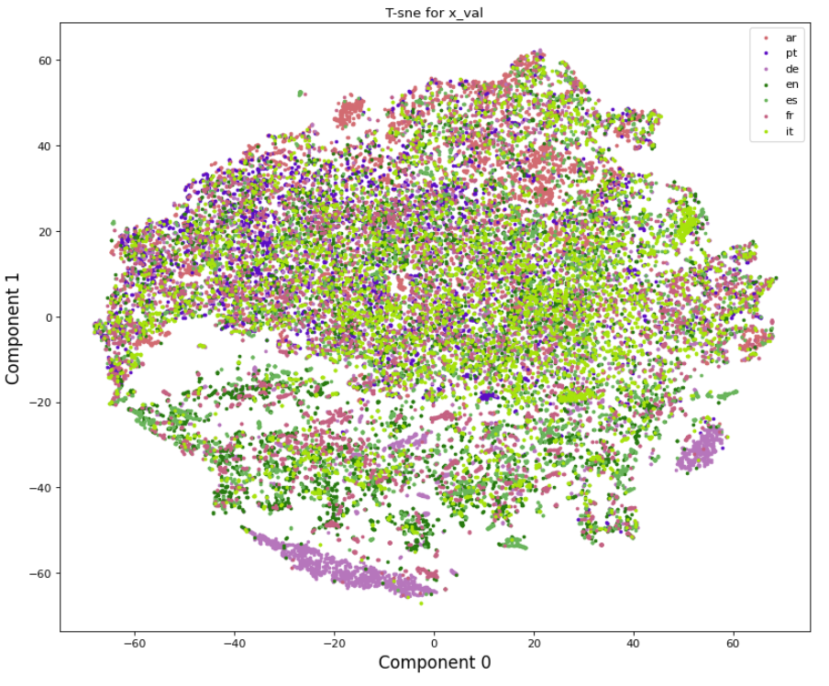
Models Building
Signals
Custom Vector
Different DL models
T-SNE plot of sample of the dataset
Sampling audios
Baseline Models
insights on Dataset

Slide 63
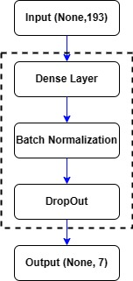
Models Building
Signals
Custom Vector
Different DL models
Sampling audios
Baseline Models
insights on Dataset
-> X 6
Model Structure

Slide 64
Models Building
Signals
Custom Vector
Different DL models
Sampling audios
After Trying Different ANN Architectures, and hyperparameter tuning.
Feature reduction :
PCA
FastICA
Baseline Models
insights on Dataset
Model Structure
Train on the full Dataset results

Slide 65
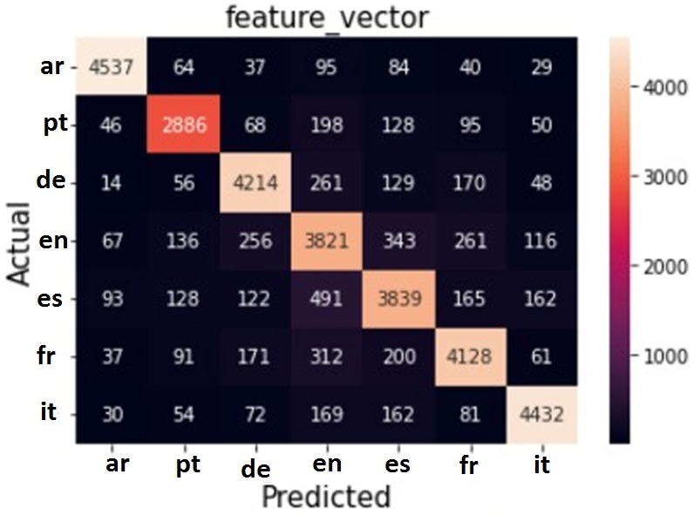
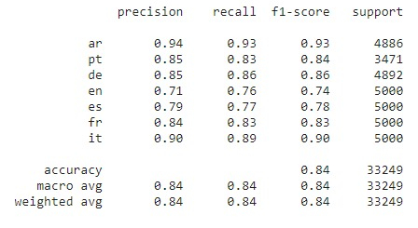
Models Building
Signals
Custom Vector
Different DL models
After Trying Different ANN Architectures, and hyperparameter tuning.
Feature reduction :PCA VS FastICA
Sampling audios
Confusion Matrix
Baseline Models
insights on Dataset
Model Structure
Train on the full Dataset results
Classification Report

Slide 66
Models Building
Signals
Custom Vector
Different DL models
After Trying Different ANN Architectures, and hyperparameter tuning.
Feature reduction :PCA VS FastICA
Sampling audios
Baseline Models
insights on Dataset
Classification Report
Confusion Matrix
Model Structure
Train on the full Dataset results

Slide 67
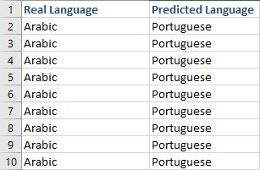
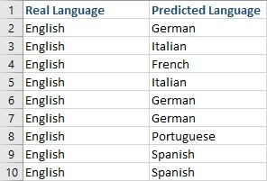
Models Building
Signals
Custom Vector
Different DL models
After Trying Different ANN Architectures, and hyperparameter tuning.
Feature reduction :PCA VS FastICA
Sampling audios
Misclassification
Classification Report
Baseline Models
insights on Dataset
Model Structure
Confusion Matrix
Train on the full Dataset results

Slide 68

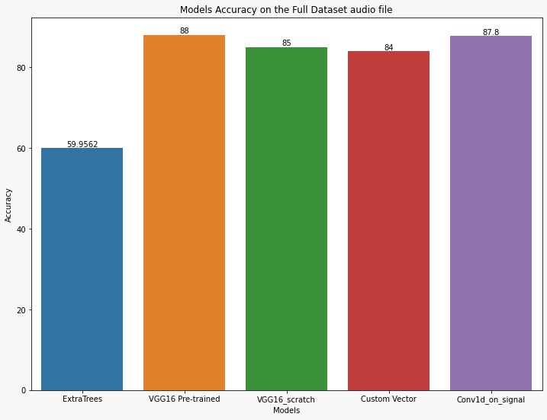
Best model selection
Comparing models' accuracy on the test data

Slide 69
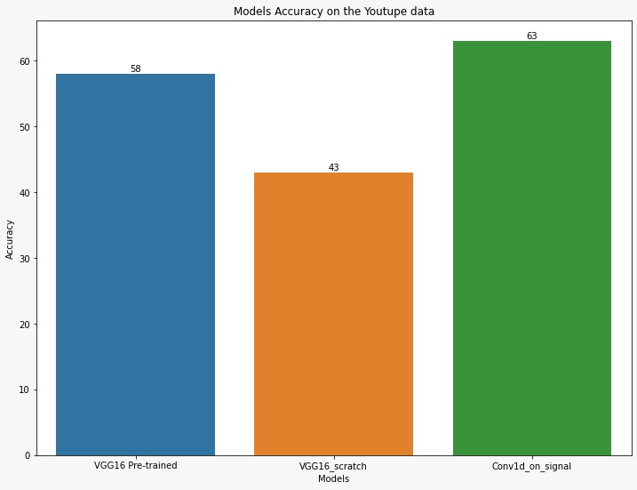
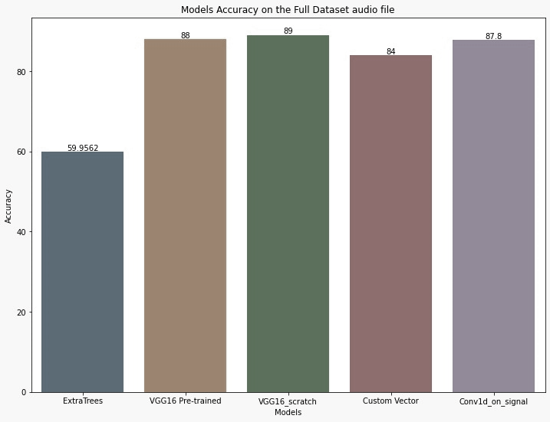
Best model selection
To select the champion model we tested the top 3 models on scrapped YouTube files
Comparing models' accuracy on the test data

Slide 70
Best model selection
To select the champion model we tested the top 3 models on scrapped YouTube files
We selected the Conve1d on the signal as the champion model because it generalizes better than other models and has the smallest size and inference time
Comparing models' accuracy on the test data

Slide 71

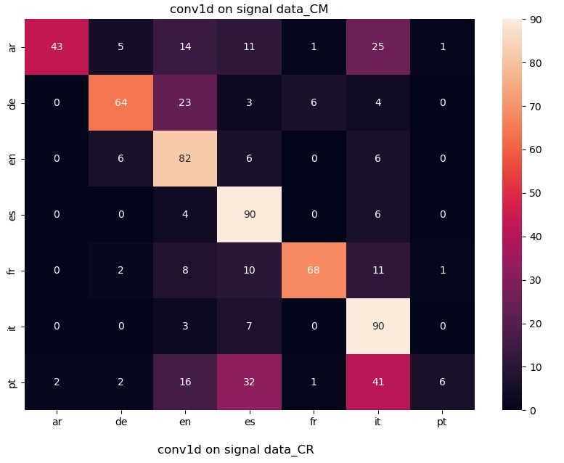
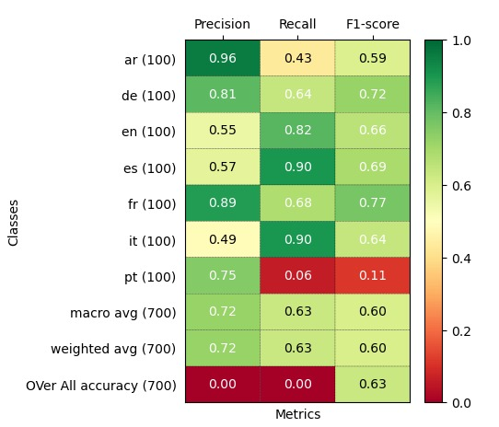
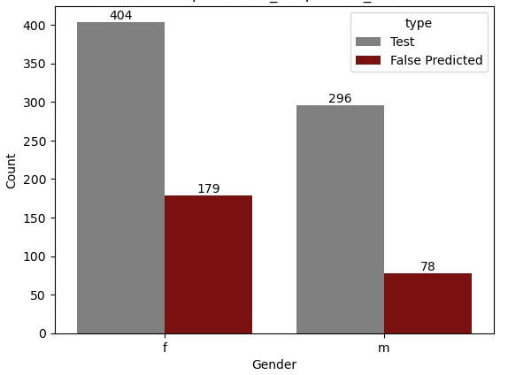
Error Analysis
The best model results on the scrapped YouTube Data
Confusion Matrix
Classification Report
Gender Misclassification

Slide 72
Error Analysis
Tested the best model on scrapped YouTube Data 100 audio for each language with 10s length for each audio
Classification Report
Confusion Matrix
Gender Misclassification

Slide 73
Error Analysis
Tested the best model on scrapped YouTube Data 100 audio for each language with 10s length for each audio
Gender Misclassification
Confusion Matrix
Classification Report

Slide 74

Comparing with related work
Method | Languages | Datasets | Accuracy
SCNN [1] | English, German, French, Spanish, and Italian | EUSpeech | 80%
Resnet50 (CNN) [2] | English, Spanish, French, German, Russian, and Italian | FoxVorg | 89%
Proposed Model | English, German, French, Spanish, Arabic, and portages | FoxVorg and Mozilla common voice | 87.9 %

Slide 75
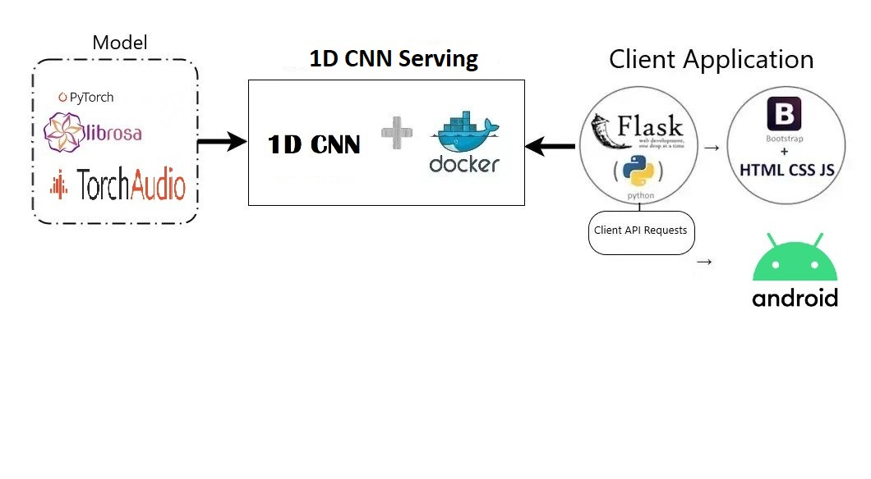
Deployment

Slide 76
Real live Demo

Slide 77

[1] chrome-extension://efaidnbmnnnibpcajpcglclefindmkaj/https:/uottawa-my.sharepoint.com/personal/araga093_uottawa_ca/Documents/uottawaGP/papers/SCNN.pdf?CT=1662494376438&&OR=ItemsView
[2] chrome-extension://efaidnbmnnnibpcajpcglclefindmkaj/https:/uottawa-my.sharepoint.com/personal/araga093_uottawa_ca/Documents/uottawaGP/papers/multiclass language detection.pdf?CT=1662494350445&&OR=ItemsView
References

Slide 78

Thank You
AI - 7
AIMs Technology
Ottawa University

